Slide 1

The Healthcare Consumer New Market. New Opportunities. New Investments.
May 17, 2013
Dr. Michael Burcham, President & CEO
The Entrepreneur Center
www.entrepreneurcenter.com

Slide 2
Agenda:
1. New Investment Opportunities in Healthcare
A Few to Watch
Energy in Nashville – Tech Enabled Services
Q&A | Conversation

Slide 3
Agenda:
1. New Investment Opportunities in Healthcare
A Few to Watch
Energy in Nashville – Tech Enabled Services
Q&A | Conversation

Slide 4


Slide 5
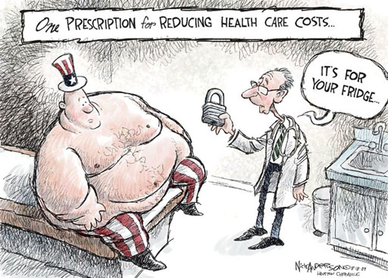
Largest Opportunity I See Today – Patient Engagement

Slide 6
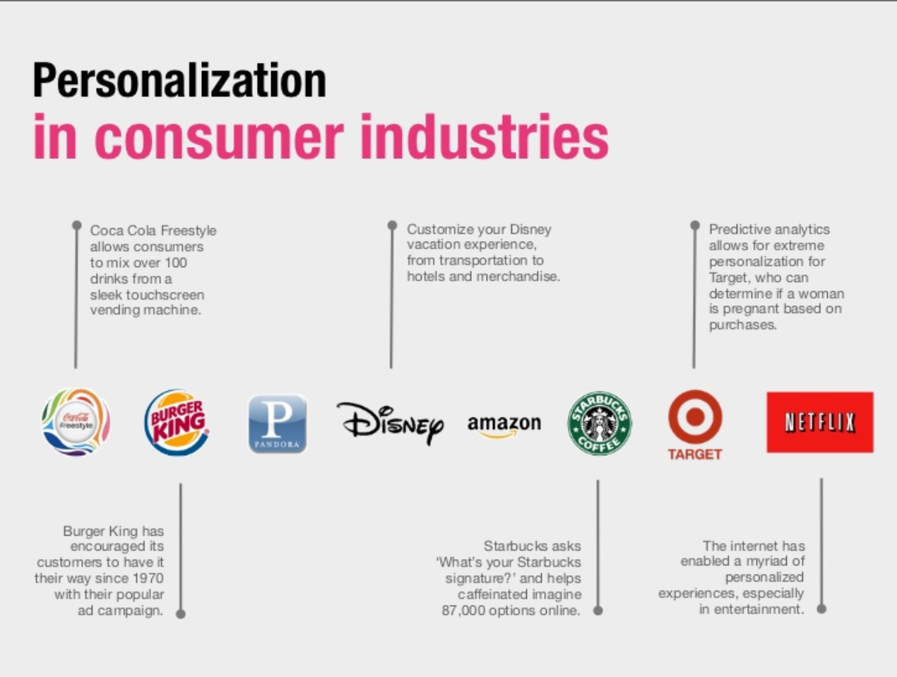

Slide 7


Slide 8
Fortune 50
Company Involvement in Healthcare
Today, 76% of the Fortune 50 companies have a connection to the health industry
24% Traditional Health Industry Categories
52%
New
Health Industry Categories

Slide 9

New Opportunities in Healthcare
Fixers
Attack dysfunction. Improve Processes. Reduce Costs.
Health System:
Consumers
Health Organizations
Government
Implementers
Thrive on Government Programs & New Regulation.
Connectors
Link Information & Tech Across System. Analysis & Context.
Retailers
High-Volume, Standardized Mkts with Low Margins.

Slide 10
The Fixers
Attack dysfunction. Improve Processes. Reduce Costs.
Insurers are paying nurse practitioners to deliver primary care.
Kiosks for patient registration.
Mobile robots for patient monitoring.
HIT systems to integrate patient records / data from multiple sources.
Fixers are simplifying the health system by applying technology and creating more efficient delivery models and care settings.

Slide 11
The Implementers
Thrive on Government Programs & New Regulation.
Integration tools to support reform changes.
Technologies to help providers adjust to new payment systems.
Tools to access information and data via smart phones and other remote devices.
Methods to provide off-site evaluations by physicians.
The overall mobile health market size is estimated to grow
from $1.4 billion
in 2008 to
$12.7 billion
by 2014.

Slide 12
The Retailers
High Volume, Standardized Markets with Low Margins
Expansion and growth of retail clinics.
Technologies to provide 24-hour support through online and telephonic hotlines.
“Big Box” retailers bring wireless and remote devices to the consumer market.
Mobile apps and tools to rate providers, check-in online, check wait times.
The overall
Direct-to-Consumer market is estimated
to grow to
$43 billion.
Consumers will
pay a premium
for access, reduced wait times, on-line check in, home monitoring tools for aging parents.

Slide 13
The Connectors
Link Information & Technology Across the System. Analysis & Context.
Data mining that drives marketing, revenue and customer satisfaction.
CRM Tools that link the hospital into the consumers’ lives.
Explosion of Social Media and information services companies – linking consumers into affinity groups, exchanges, rating systems, costs.
In 2010
92% of hospitals reported using some form of social media to reach consumers,
but only
13%
reported that social media use was driving an increase in patients and revenue.

Slide 14
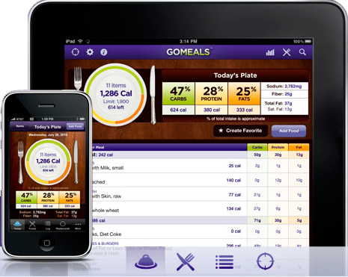
Tools that empower patients
Sanofi-Aventis created GoMeals to support people managing their diabetes. The clever app has calculators and tools that make mealtime decisions easier.
~3,000 people per month visit the GoMeals site. The app itself has 264 reviews across two app stores with an average rating of
3.5 – 4 stars.

Slide 15

And tools that power lasting commitments
50% of people who should get colonoscopy screenings choose not to. The reasons are familiar: it’s scary, the prep is awful. Salix decided to create a tool that answered all their real questions – in the voice of someone like me.
Up to 50,000 visitors/month
Used on provider sites
30,000 requests for printed copies
200 hospital requests
2,000 HCP requests

Slide 16

The Wired Consumer
2000
2013
Online Health Information Seekers
68M
192M
Physicians Online
37%
99%
84% of these onsider online access critical to their work
Average Annual Healthcare Spending Per Person
$4500
$8650
US Healthcare Expenditures Annually
$1.4T or 14% of GDP
$2.5T or 18% of GDP

Slide 17
Agenda:
1. New Investment Opportunities in Healthcare
A Few to Watch
Energy in Nashville – Tech Enabled Services
Q&A | Conversation

Slide 18

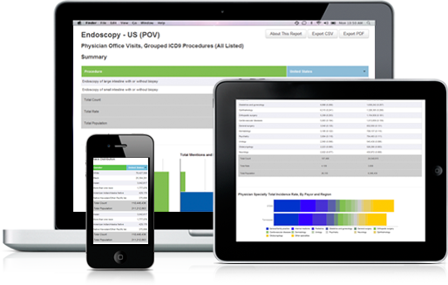

Slide 19

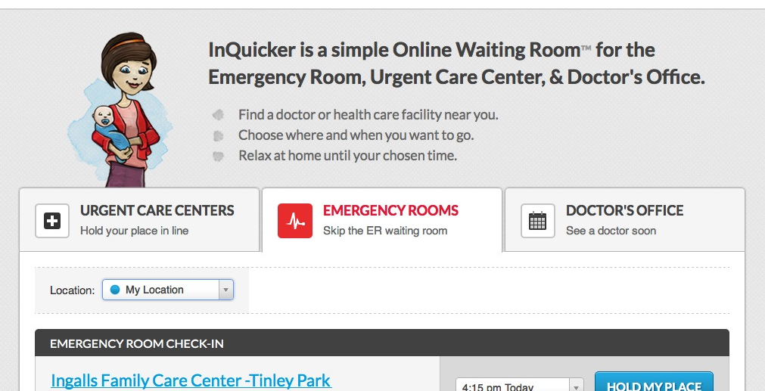

Slide 20
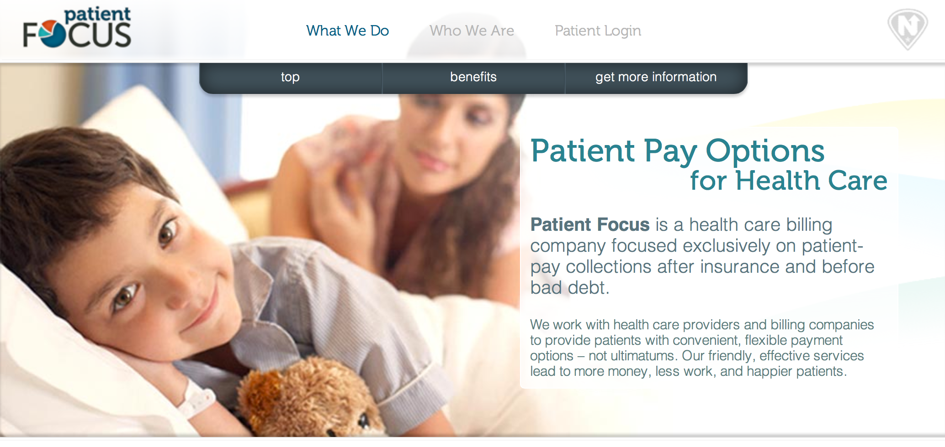

Slide 21


Slide 22
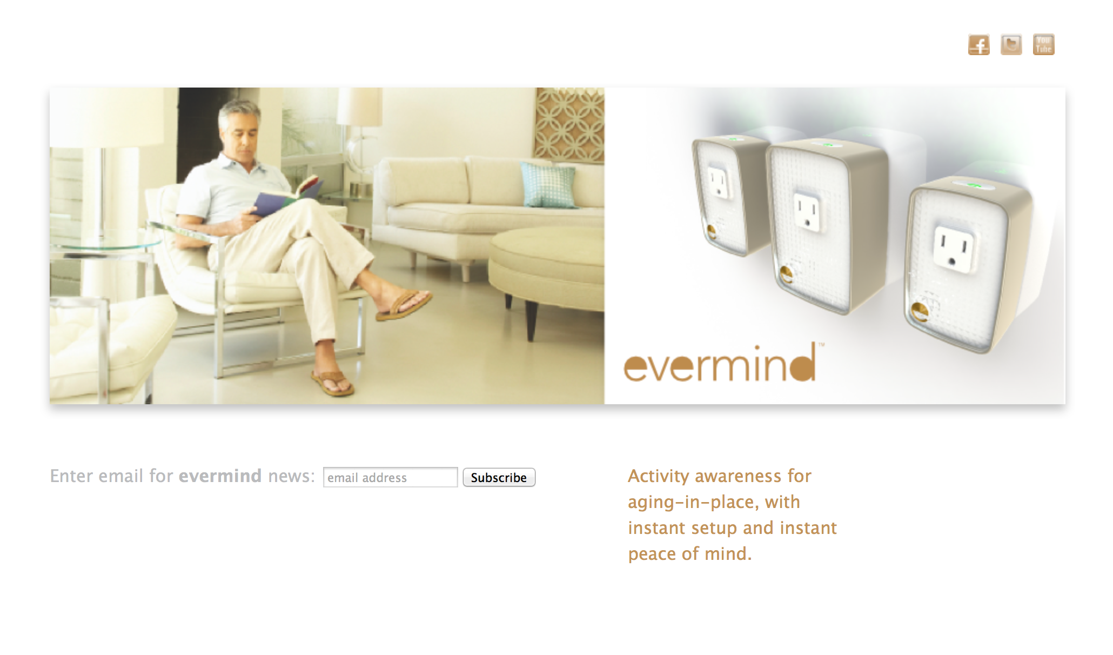

Slide 23
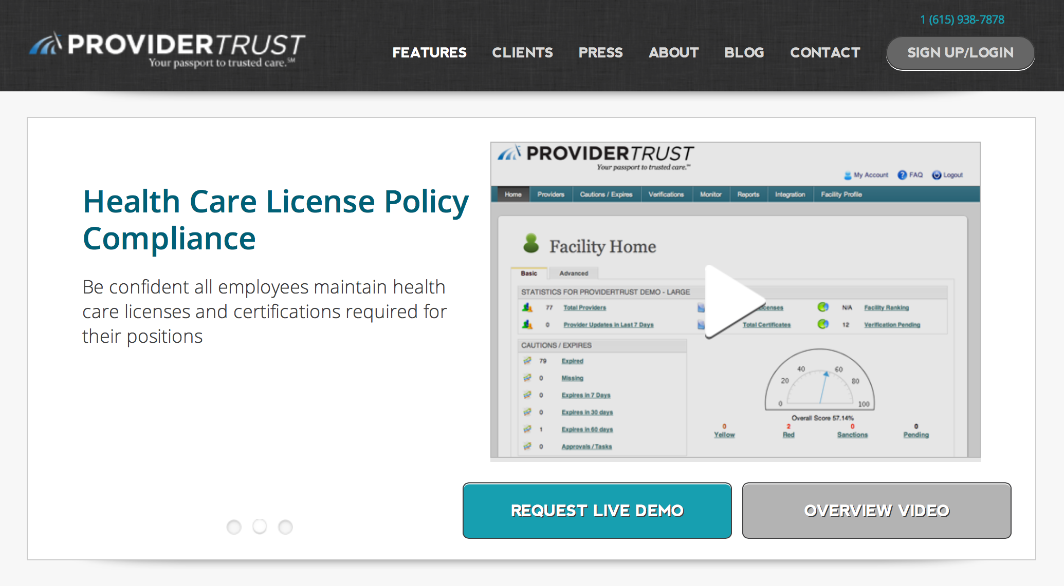

Slide 24
Agenda:
1. New Investment Opportunities in Healthcare
A Few to Watch
Energy in Nashville – Tech Enabled Services
Q&A | Conversation

Slide 25
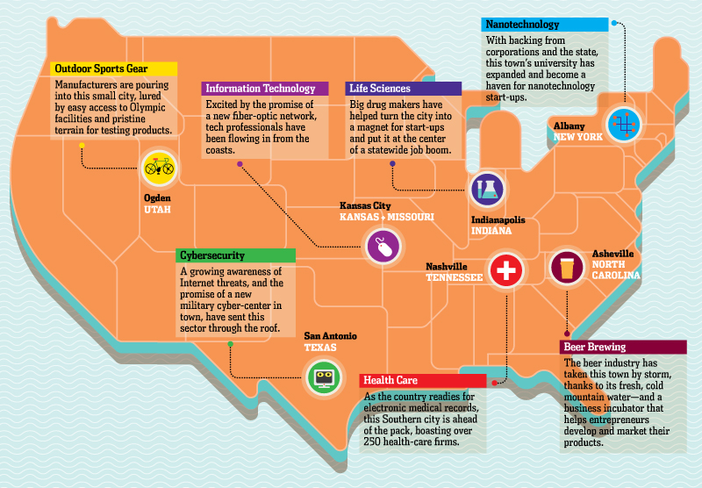
In 2012 the Wall Street Journal as one of 7 great Startup Cities,
Specifically citing our work in Healthcare Startups.

Slide 26
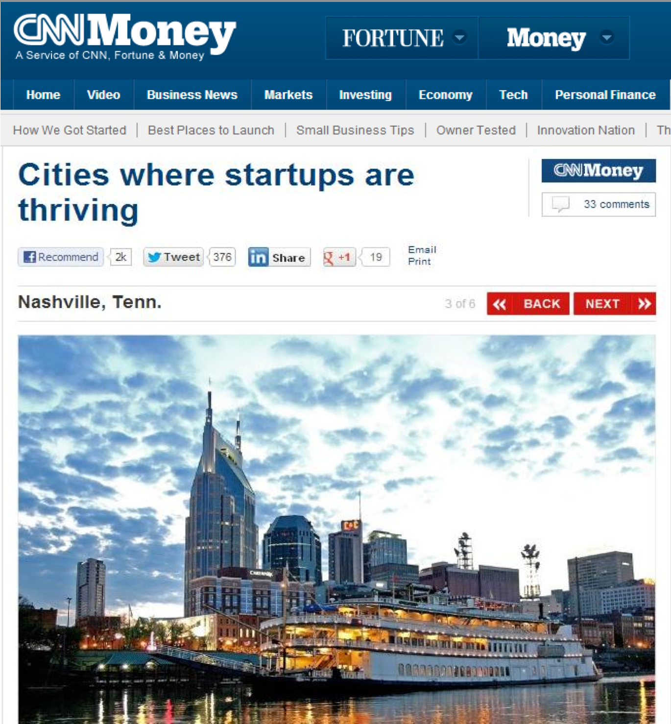
January, 2013:
CNN Ranked Nashville
#3 in America for Startup Entrepreneurs
5 Years Earlier, we’d not made the Top 20.

Slide 27


Grand Opening
06.20.13
Expands to 20,000 sf of space
Linked with Venture and PE Firms
50 HC Startups in 30 months
$20mm Seed & Angel Capital
27

Slide 28
Agenda:
1. New Investment Opportunities in Healthcare
A Few to Watch
Energy in Nashville – Tech Enabled Services
Q&A | Conversation

Slide 29
